Slide 1
Python Learning break your #excel addiction
Part-2

Slide 2
Python for Finance
http://www.ebooksbucket.com/uploads/economicsandfinance/finance/Python_for_Finance.pdf
http://pandas.pydata.org/pandas-docs/stable/
http://pbpython.com/excel-pandas-comp.html
http://pandas.pydata.org/pandas-docs/stable/10min.html#selection-by-label
http://pandas.pydata.org/pandas-docs/stable/cookbook.html#cookbook
http://synesthesiam.com/posts/an-introduction-to-pandas.html

Slide 3
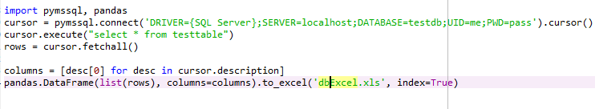
One liner programming for database to excel

Slide 4
One liner programming for REST APIs to excel

Slide 5
Pandas: Export Data
df.to_csv(‘jsonExcel.csv', index=False)
df.to_excel('jsonExcel.xls', index=False)
df.to_csv('jsonExcel.txt', index=False)
Pandas: Import data
df = pd.read_excel("sample-salesv3.xlsx")

Slide 6
Play with excel: Adding a Sum to a Row
In Excel, pretty straightforward formula
- sum(G2:I2) in column J
In Pandas
- df["total"] = df["Jan"] + df["Feb"] + df["Mar"]
Appending a column sum as a new row
- refer code example
group By clause

Slide 7
Column level analysis
Sum
- df["Jan"].sum()
Mean
- df["Jan"].mean()
Min
- df["Jan"].min()
Max
- df["Jan"].max()

Slide 8
Filtering the data
df[df["account number"]==307599]
df[df["quantity"] > 22].head()
Use map to filter some complex filtration
- refer code examples for better understanding
“isin” Function to define list of criteria values
- refer code examples

Slide 9
Working with Dates
Complex filtration with dates is supported
Partial filter with dates
Pandas understands quite well
- see code examples
df[df['date'] >='20140905'].head()
df[df['date'] >='2014-03'].head()
df[(df['date'] >='20140701') & (df['date'] <= '20140715')].head()
And many more…

Slide 10
Additional string functions
support for vectorized string functions as well
- contains function to search within cell value
- see code examples
Find list of unique items in list
- use of unique function
- df["name"].unique()
- view code examples
Slice list of columns
- Example: first and second columns ix[:,[0,1]]

Slide 11
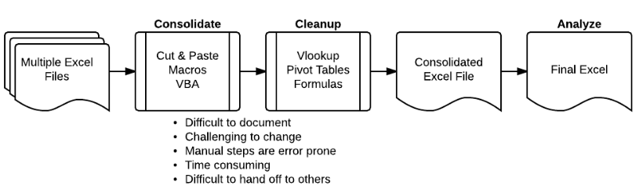
Combining Data From Multiple Excel Files
automate the process of aggregating data from multiple files and spreadsheets
Traditional style

Slide 12
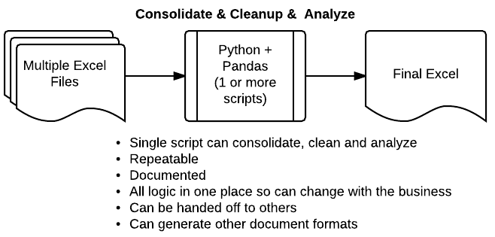
Python + Pandas: A Great Alternative
much more scaleable and powerful

